Slide 1
Conception inclusive et accessibilité
Volet conception
SNC

Slide 2




Intro
Bonjour! Je m’appelle Julianna. Mon travail consiste à aider le Service numérique canadien à établir des services accessibles et inclusifs pour la population canadienne.
julianna.rowsell@cds-snc.ca
https://github.com/jrowsell
@juliannarowsell

Slide 3
Activité brise-glace – Incidences de l’accessibilité, de l’inclusion et de l’exclusion
Notes:
A More In-Depth Primer
When working with anyone new to thinking about inclusive design, I like to have them perform an in-depth thought experiment.
It goes something like this:
There’s a moderately heavy door ahead that swings out towards you. There is a bright light just above the door, shining down. Vertical bar handles are on either face and it is locked by a keypad on the left.
How do you get through the door?
Now imagine you are holding bags of groceries in each arm. How do you open the door?Imagine you are on crutches. How, now?What if you are in a wheelchair?What if you just went to the eye doctor and your pupils are dilated?
What if you can’t see at all?
This thought experiment sheds light on how we can better make things for all people. Instead of thinking about simply designing a door, we can start to look at the door (or any other product) from multiple vantage points and different types of interactions.

Slide 4
Activité 1 : Pensez à une occasion où l’accessibilité, l’inclusion ou l’exclusion ont directement touché une personne que vous connaissez, ou vous-même.
Notes:
Briefly write that down on a post-it note. Associate the situation and feelings that this experience created.
Time: 20 minutes

Slide 5
Qu’est-ce que la conception inclusive?
Notes:
Time 40 minutes

Slide 6
Qu’est-ce qu’une conception inclusive?
lieu
genre
langue
éducation
culture
Conception inclusive
Accessibilité
vision
ouïe
cognition
mobilité
Notes:
Considers the full range of human diversity with respect to ability, language, culture, gender, age, and other forms of human difference. The same thinking can, and should be applied to neurological, cultural, ideological, or environmental viewpoints. Those, too, can play a huge factor into how people use and interpret products and their design.
Of course, thought experiments are only a good first step. They pale in comparison to all the great amount of data and insights obtained by user testing and interviews. The absolute best way to design for multiple situations is to work with the people who live through them. Again, interviews and testing reveal loads of information that mere thinking cannot.
Inclusive Design isn’t solely about making sure a small percentage of the population can use your product. It’s about making sure anyone, in any situation, can use your product. And that benefits everyone.

Slide 7
Diversité
Comme dit Jutta Treviranus, du centre de recherche en conception inclusive*, la diversité est le plus précieux atout de notre monde, et l’inclusion, notre plus grand défi.
*de l’Université de l’École d’art et de design de l’Ontario
Notes:
In broad terms, diversity is any dimension that can be used to differentiate groups and people from one another. It means respect for and appreciation of differences in ethnicity, gender, age, national origin, disability, sexual orientation, education, and religion.

Slide 8
Inclusion
L’inclusion, c’est la valorisation, le respect et le soutien. Elle consiste à mettre l’accent sur les besoins de chaque personne et à s’assurer de mettre en place les conditions nécessaires pour que chaque personne s’épanouisse pleinement.

Slide 9
Pourquoi tous profitent-ils d’une conception axée sur l’accessibilité?
Une conception inclusive ouvre les services et les expériences à un plus grand nombre de personnes dotées d’une plus large gamme de capacités. Chaque jour, tous les êtres humains grandissent, changent et s’adaptent au monde qui les entoure. Nous voulons que nos conceptions reflètent cette diversité.
Notes:
Every decision we make can raise or lower barriers to participation in society. It’s our collective responsibility to lower these barriers though inclusive products, services, environments, and experiences. Think about a time when you really needed to send a text message but your hands were busy. Maybe you were washing the dishes, which meant your hands were soapy and wet, making it difficult to use the touchscreen. Instances like these are common but they aren’t constant. You’re not perpetually washing dishes.
Now, ask yourself, “What if my hands were always busy? What if I couldn’t use my hands at all?”
Empathy should be at the heart of all User Experience design. The first step to building it is to think about the times when you’re not able to do the tasks you typically can. Those times can be frustrating, but they’re informative, as well. Inclusive Design aims to solve those frustrations, for all people, by looking at each problem from different perspectives.
By creating features that account for those times when you can’t use your product the way you typically do, you end up creating for people who may not be able to use it at all. This allows more people to use your product, more often. In the case of websites, the outcome could mean more traffic, which in turn potentially means more revenue.
Also consider that word of mouth is the most influential marketing strategy, thus it can also be the most damaging. If you don’t create accessible features for your site or product, potential users may not spread the word about it. You may end up isolating people who may otherwise become your best advocates. Worse, they may actively avoid it and suggest others do the same.

Slide 10
Ne pas faire de supposition
Si on veut concevoir de façon inclusive, il faut se rappeler que toutes les personnes ne peuvent pas utiliser vos produits de la même façon, ou de la façon dont vous les avez conçus. Ne faites pas de supposition sur la façon dont les gens utilisent vos services. Chaque personne utilise diverses approches pour bien répondre à ses propres besoins. Il n’existe pas d’utilisateur moyen ou « normal ».
Notes:
For example, when building websites, consider how not everyone can control their computers the way you do. They may not be able to see the screen at all or may not have the mobility to push a mouse.
Inclusive Design is more than meeting accessibility compliance. It is much more than simply checking a few boxes to make sure colour and contrast ratios meet standards. Inclusive Design starts at the very beginning of any project, before pixels get pushed, before pens even hit sketchbooks.
Let’s take the previous thought experiment a step further. At the beginning of your next project consider asking, “How would this product work if I couldn’t see it? What if I couldn’t touch it, or move it? What if I couldn’t hear it, taste it, smell it?” This will help you think about people's pain points and usages differently, lending some guiding principles toward the design of your product.

Slide 11
Qu’est-ce que la recherche en conception?
Notes:
Talk to users Talk to users Listen to their concerns Respect their capacities
Inclusive design extends the benefits of good accessibility to a wider audience. Bad inclusive design compromises good accessibility.
Don’t make something cool if it reduces access to users with essential needs. If you do want a good inclusive design story then there are lots of them in Audio design.
Wayfindr and SeeingAI are both products developed with people with visual impairments that have great futures due to their inclusive design for everyone.

Slide 12
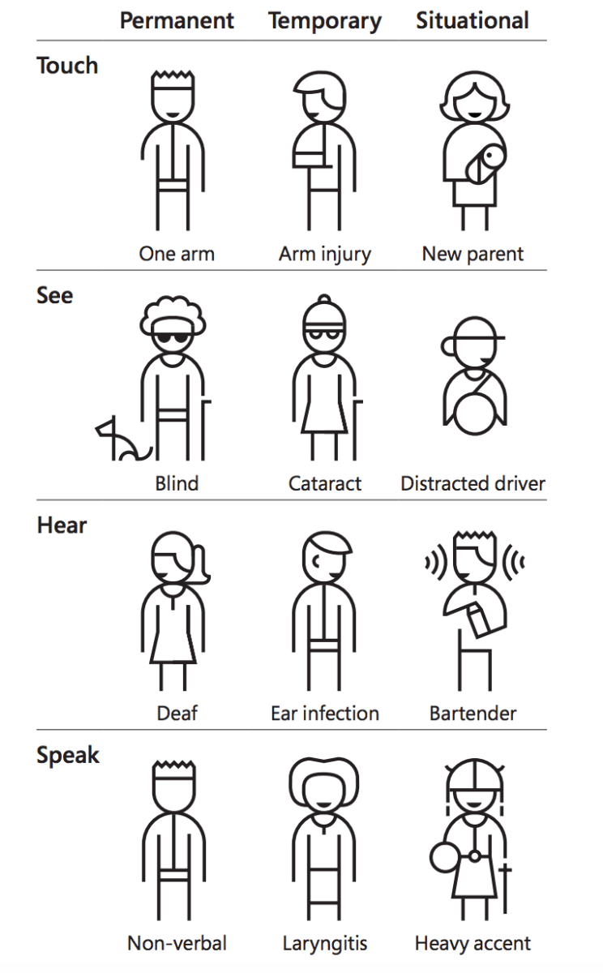
Conception inclusive
Temporaire
Circonstanciel
Toucher
Un bras
Bras blessé
Jeune parent
Reconnaître l’exclusion
« Le handicap n’est pas simplement un problème de santé. Il s’agit d’un phénomène complexe qui découle de l’interaction entre les caractéristiques corporelles d’une personne et les caractéristiques de la société où elle vit. »
–Organisation mondiale de la santé
Voir
Cécité
Cataracte
Distraction au volant
Entendre
Surdité
Otite
Barman
Parler
Laryngite
Accent marqué
Notes:
Learn from diversity
People adapt to diversity in unexpected ways. Putting people in the centre of the design process from the start lets us to gather valuable insights which would not have been considered else.
Solve for one, extend to many
A solution that works well for someone might also benefit other persons. Inclusive design works across a spectrum of related abilities, connecting different people in similar circumstances. For instance a solution designed for people with one arm might help people with an arm injury or a new parent who has situational disability to use both the hands.

Slide 13
Reconnaître les préjugés
Lorsqu’un utilisateur se sert de votre produit, cette utilisation peut être limitée à divers degrés, allant de très temporaire à permanent.
Notes:
A user might be washing dishes, holding their newborn child, have a broken wrist, or be an amputee. Get to know the people who might be using your product. Try to understand them and their pain points, their needs, their motivations. Look at your product through their eyes as much as you possibly can. Even more importantly: interview them and have them test your product – repeatedly, if possible.
Naturally, we tend to design for how we individually might be able to use a product. We consider interaction models – swipe, tap, pinch, click, slide, etc – that we, ourselves, are able to perform. That’s designing to our own capabilities. Sometimes, designers can step outside of themselves and consider how to use their product as someone who has a different set of capabilities. This is problematic, though. We easily fall into the trap of thinking people are only capable in one interaction or another. This limits our ideation around interaction methods, and stops us from thinking across different perspectives.
Some abilities and limitations are permanent, some are not. Capabilities change, and change often, depending on the situation. When we design for situations, we start to approach them from multiple angles. We can brainstorm new, different ideas as to how to solve a problem outside of a limited set of capabilities.

Slide 14

Piliers de la conception inclusive
Aucun utilisateur n’est moyen.
Chaque utilisateur mérite un accès égal.
Fournir un contenu facile à comprendre pour tout utilisateur.
Chaque utilisateur mérite notre confiance et notre respect.
ASCENSEUR
Notes:
Inclusive Design
Recognize diversity and uniqueness (people and places)
Personalize (wherever possible, let people be themselves - empower users )
Ask yourself: was that design choice really brilliant or did I just exclude someone? (beware of introducing assumptions)
How do I bridge the gap I just created? (Identify the gap, between the core and the outliers - you’ll see quite tangibly where innovation can happen.)
The magic is at the margins * Innovation is often driven from meeting needs (speech recognition, speech to text, voice assistants) * Benefits the majority
Supports the spectrum
Resilency
EDGE | Outliers
How many of you consider yourself average? So why do we design for the average?
Use inclusive process and tools - get experts to make the best solutions - talk to people to find out what works for them, and what conditions that they might be using them in?
Have a broader benefitical impact - solve for everyone, the goal is to be better than yesterday.

Slide 15
Les processus de la conception inclusive
Sont itératifs
Préciser le contexte d’utilisation (qui, quoi, où)
Découvrir, comprendre et traduire les désirs et les besoins de l’utilisateur
Font appel à la participation des intervenants et des utilisateurs finaux
Adapter et appliquer les lignes directrices et les normes
Évaluer la conception en fonction des besoins et la mettre à l’essai

Slide 16
Quelle est la différence entre conception inclusive et accessibilité?
Notes:
While inclusive design considers from the very beginning how something might be easily useful and enjoyable for as many individuals as possible, accessibility traditionally means making special considerations for people with disabilities. It’s the difference between designing a watch that can be read by touch or sight, and taking a standard analog watch and adding braille instead of numbers. The first example considers the functionality and beauty of a watch that doesn’t require sight, while the second example tries to take something designed for vision and make it work for touch without addressing some of the problems this modification creates.
Unlike assistive devices, inclusive design doesn’t specifically target people with disabilities. While assistive devices fill in the gaps left by exclusionary design practices, inclusive design aims to evolve products beyond their conventional definitions, changing our standards for products. Assistive devices aim to remove a barrier for people with disabilities. Inclusive design strives to fundamentally redesign a product so that the barrier does not exist in the first place. Assistive technology is reactive. Inclusive design is proactive.

Slide 17
Accessibilité | Conception et développement inclusifs
Anciens sites et applications (existants) | Sites et applications résultant d’une conception et d’un développement nouveaux
Vérification | Mesures correctives | Mise à l’essai | Recherche sur les utilisateurs | Développement sémantique, axé sur les normes
Conception (expérience utilisateur / visuelle) | Assurance de la qualité | Essai par les utilisateurs
Notes:
Accessibility is the awareness of, attention to, and remediation of existing factors that prevent individuals with varying abilities from performing tasks or obtaining information. It’s global in nature.
In my experience, sadly, it is rare for accessibility to get appropriate and timely attention and consideration at the beginning of a project. In many cases, accessibility is a last minute “fix” or a “fast follower” task after a launch.
With real-world accessibility activities, sites or apps are reviewed and analyzed for their compliance to standard guidelines for accessibility, such as the Web Content Accessibility Guidelines (WCAG).
Violations are reported and recommended remediations (fixes) are designed, developed and implemented, typically with the least amount of visual change as possible.
These items must go through a quality assurance phase, and often, are sent back for re-development work. In some cases (yet not enough), proper usability testing is performed, typically when mandated or due to legal action.
These activities tend to make what is lacking accessibility, more accessible, while really not changing much in the design, except for accessibility issues such as color contrast.
Efforts are expensive, as it takes more time and resources to remediate sites and apps than it would if they had been created in an accessible manner at the beginning.
Additionally, much of remediation work only includes compliance fixes. It doesn’t alter the user experience, as this would be potentially intrusive to the design.
You’ll find many compliant websites which offer poor experiences for people with disabilities.
If accessibility is considered upfront, by design, and developed in accessible ways, accessibility can be a seamless facet to the entire workflow process. This, in my mind, is considered inclusive design and development.

Slide 18
Conception de profils inclusifs
Notes:
Imagine performing user research and developing personas that include individuals with low-to-no vision, or individuals who are deaf or hard-of-hearing.
Also consider individuals using non-mainstream input devices and assistive technology, such as switches, or puff and sip.
Moreover, considerations are needed for cognitive and learning impairments that are invisible to the eye.
Your group of designers will now need to recognize more than color contrast when creating designs.
Font and UI element size and spacing, proper organizational and semantic headings and sub-headings, impact of accordions, tooltips, sliders, toggle buttons and carousels, all of these factors are more readily addressed during the design phase rather than while remediating, when design changes may be required.
With the knowledge of accessibility considerations upfront, accessibility will find itself seamlessly in the resulting designs.
Developers, who for years have been accustomed to leveraging non-semantic elements like divs and spans to perform their scripted magic, now need to think holistically about code semantics and craftsmanship as they approach development.
They’ll also need to pay attention to the relationships between labels, input fields, and their messaging, as well as the roles, properties, and states of custom widgets.
Inclusive Design addresses the second portion of that famous quote, “Teach a designer or developer to design and develop in an accessible manner, and they will consider it in all their work.”
Rather than focusing on providing remediation steps, teach accessible considerations when designing or coding upfront.
You’ll reduce the time and resources needed to repeatedly remediate websites and apps.
And that is better for all.

Slide 19
Le problème d’une bonne conception : pourquoi une bonne conception ne suffit pas
Notes:
The truth is that “good design” considers the best form and function for some people, but excludes many people on the basis of ability — and individuals with disabilities are often left out. We want to change that.
Design should be inclusive, bringing more people in instead of shutting them out. We believe that design shouldn’t discriminate or divide us up, but bring us together.
Individuals with disabilities should have equal and integrated access to quality products, services, and structures — that everyone has a right to enjoy beautiful, functional design, and that we all benefit when we enjoy design together.

Slide 20
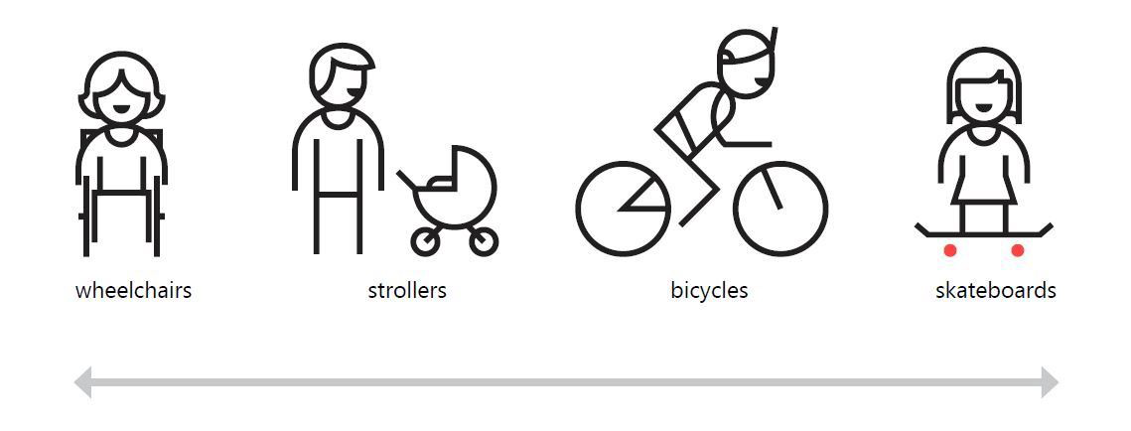
Nous sommes tous handicapés dans certaines circonstances
fauteuils roulants
poussettes
bicyclettes
planches à roulettes
Notes:
We all can be considered disabled in some scenarios. When driving a car, touch interaction is impaired. Everyone can benefit from inclusive voice-control (assistants like Cortana or Siri for example). Having a newborn on your hands? You’re limited to one hand for interaction with a smartphone. You are disabled. Temporarily. My favorite example are curb cuts for easier and safer crossing the street on a wheelchair. It is mainly for people with permanent disabilities and can seem like a significant design constraint, but… it actually also helps people with strollers, kids on a bicycles or can save you from injury. Inclusive design is simply better design.

Slide 21

Recherche en conception et mise à l’essai Examiner les enjeux d’accessibilité et de conception inclusive dans la recherche sur les utilisateurs. Tenir compte des handicaps visuels, auditifs, moteurs et cognitifs possibles. Intégrer les facteurs d’accessibilité dans vos profils, ou dans vos histoires d’utilisateurs. Dans la mesure du possible, inclure des utilisateurs ayant diverses capacités dans la recherche sur les utilisateurs.
Notes:
References: Personas for accessible UX

Slide 22
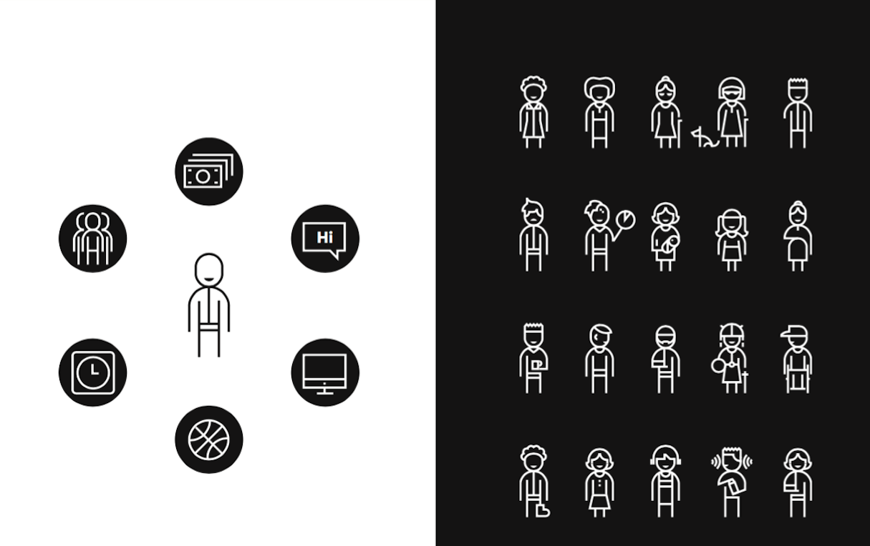
On ne peut pas assumer que tous les sens et toutes les capacités sont toujours pleinement fonctionnels
Notes:
Microsoft’s Inclusive Design Tookit argues that there’s no such thing as ‘normal’ and that we can’t assume all senses and abilities are fully enabled all the time.

Slide 23
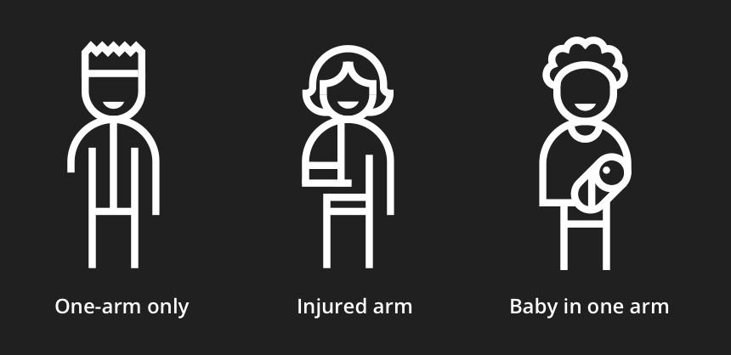
Exemple de handicaps permanent, temporaire et circonstanciel
Un seul bras
Bras blessé
Bébé dans les bras

Slide 24
Concevoir avec empathie
L’empathie peut nous aider à mieux percevoir et comprendre les besoins émotionnels et physiques des personnes. Cela comprend la façon dont elles voient le monde qui les entoure, le comprennent et interagissent avec lui.

Slide 25
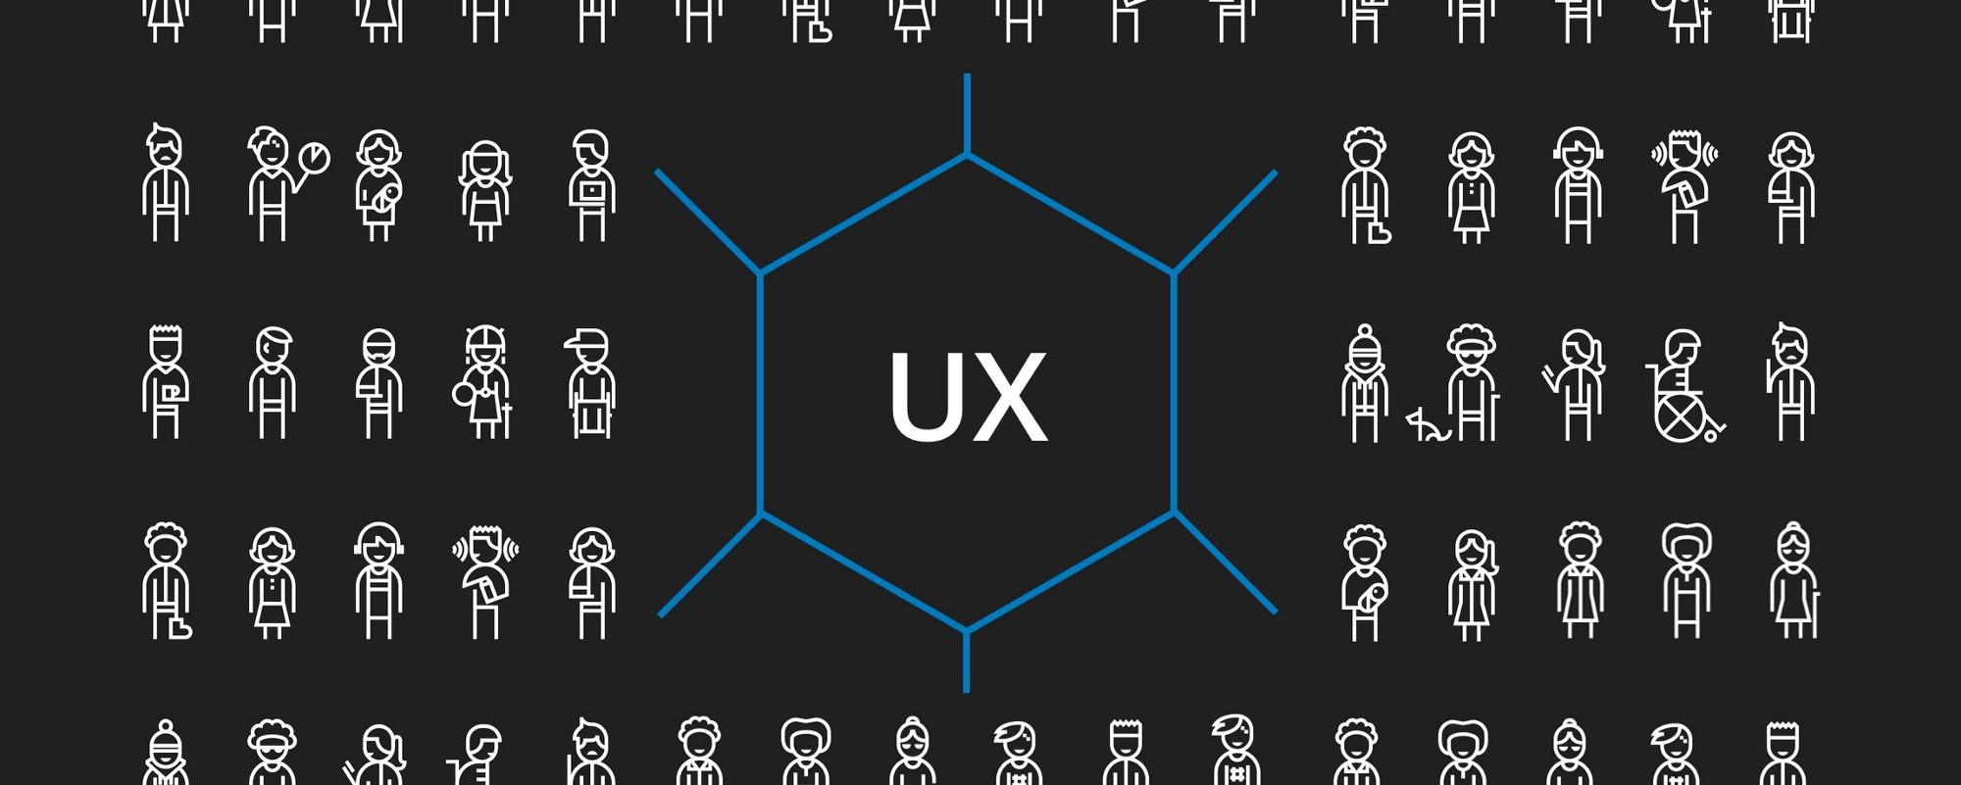
Expérience utilisateur
Notes:
As a UX designAccessibility allows users of all abilities to understand, use and enjoy the web. As designers, it is our responsibility to make sure we design in a way that is usable to all users irrespective of their situation, abilities or context.
The first and foremost step to build an accessible product is to build empathy and install an inclusive design mentality.
Accessibility is not confined to a group of users with some different abilities, for example, visual, motor, auditory, speech, or cognitive disabilities, rather it extends to anyone who is experiencing any permanent, temporary or situational disability, e.g., having only one arm is a permanent condition, having an injured arm is a temporary, and holding a baby in one arm is situational — in each case the user is able to complete tasks with only one hand.
Therefore, the aim is to make web content more usable to users in general, it is important to build empathy and celebrate accessibility requirements as a set of design constraints to build a better product. Accessibility is a vast subject. This article focuses mainly on guidelines specific to designers and content writers (to some extent) that would help to build a more accessible product.

Slide 26
Vidéo – Sinead Burke – Pourquoi la conception devrait-elle inclure tout le monde?
Notes:
Time: 15 Minutes

Slide 27
Ces hypothèses sur la conception sont étroites
Une conception inclusive nuira à l’expérience de la majorité des utilisateurs.
Un handicap est un état de santé personnel (permanent).
La plupart d’entre nous n’avons pas besoin d’une conception inclusive.
Processus de conception inclusive
Une conception inclusive nous permet d’atteindre beaucoup plus de gens.
Un handicap peut survenir n’importe quand et n’est pas nécessairement permanent.
La plupart d’entre nous bénéficions d’une conception inclusive.
Notes:
If we start our design process narrow-minded, concentrating on familiar demographics, regions, personal abilities or languages, we will end up with a product of limited application. It will be bad for users, but also bad for us — product makers. Designing inclusively lets us to reach much broader audience with things we create. Inclusive design helps improve customer satisfaction. It’s pure profit — for both sides.
Second, I had to change my understanding of what disability is. Old definition concentrates on biological or mental part of this problem, describing it as a health condition. Inclusive design approach brings us much broader meaning of disability. “Disability is designed”. It’s not a personal attribute or health condition, it’s a mismatch in human interaction with other humans or environment. If we think about it that way, disability is not a state nor property. It’s more like situation.

Slide 28
Il faut des concepteurs qui ont rencontré des obstacles. Nous ne voulons pas former un groupe homogène de personnes possédant des compétences particulières, mais un groupe de personnes qui apportent des perspectives variées et qui peuvent travailler en équipe.
Une conception inclusive ne signifie par que vous concevez une chose pour toutes les personnes. Vous concevez une diversité de moyens de participer pour que chaque personne ait un sentiment d’appartenance. - Susan Goltsman (traduction)

Slide 29
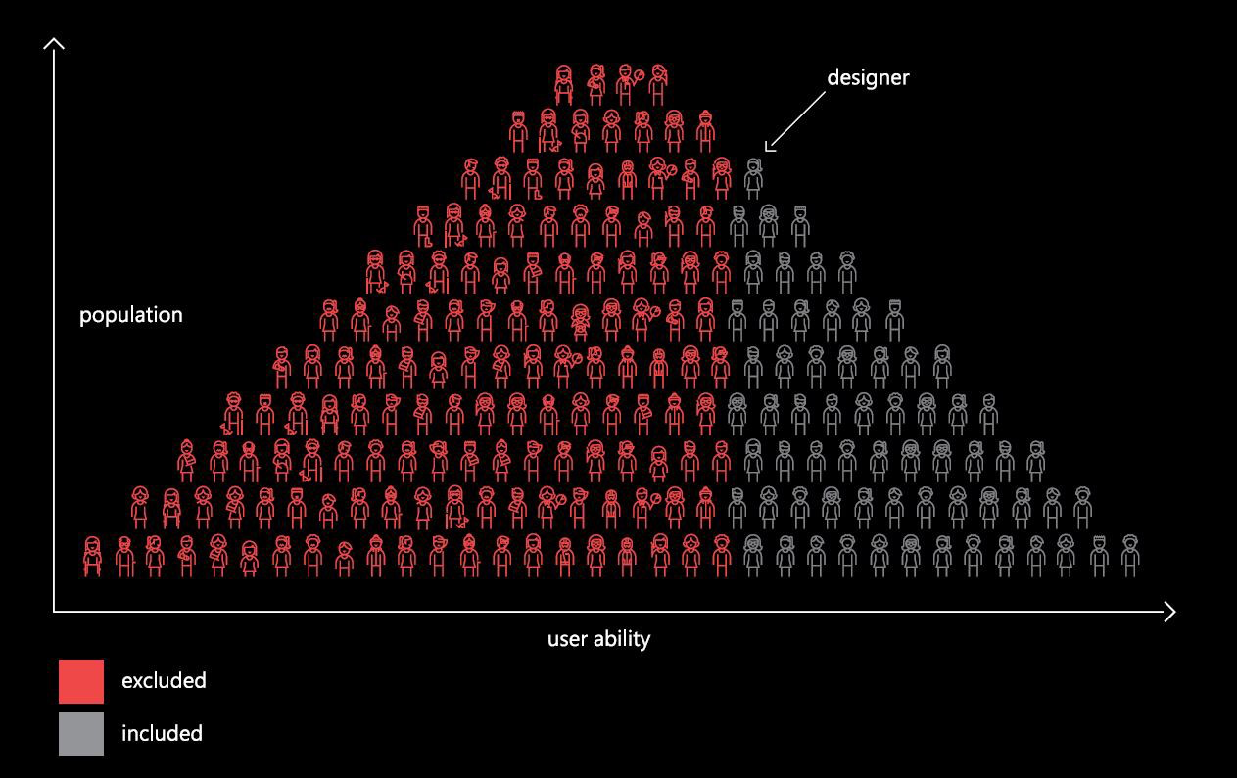
concepteur
capacité de l’utilisateur
exclus
inclus
Notes:
Microsoft Inclusive Design Toolkit

Slide 30
Deux personnes qui ont le même handicap ne sont jamais identiques
Surdité de naissance
Perte auditive partielle
Perte auditive survenant au cours de la vie
Difficulté auditive dans une salle bondée
Cécité de naissance
Cécité survenant au cours de la vie
Perte de vision
Fatigue oculaire découlant d’une surstimulation

Slide 31
La conception inclusive prend racine dans l’accessibilité. Elle se définit comme un ensemble de pratiques qui peuvent être appliquées à tout processus de conception existant. L’inclusivité désigne la façon de concevoir. Elle qualifie nos outils et nos méthodes. L’accessibilité offre plutôt des moyens d’améliorer l’accès à ce qui est déjà conçu.
Un plan incliné ne supprime pas la bordure du trottoir, mais il la rend plus accessible. La conception inclusive nous donne des moyens de concevoir en fonction de l’évolution continue des motivations et des besoins des humains, et de concevoir des systèmes qui peuvent être modifiés pour satisfaire à ces divers besoins.

Slide 32
Vidéo – Élise Roy – Quand notre conception tient compte du handicap, tout le monde en profite (pensée conceptuelle)
Notes:
Time: 15 Minutes

Slide 33
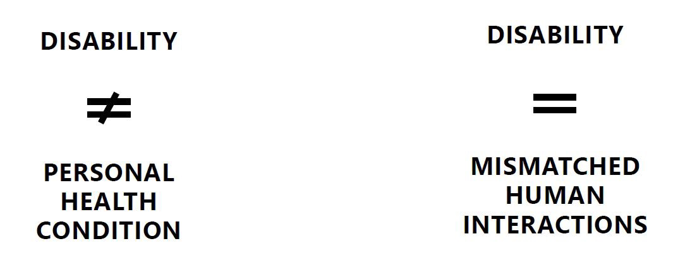
Comment pouvons-nous résoudre une incompatibilité?
HANDICAP
HANDICAP
INTERACTIONS HUMAINES INCOMPATIBLES
ÉTAT DE SANTÉ PERSONNEL
Notes:
We all can be considered disabled in some scenarios. When driving a car, touch interaction is impaired. Everyone can benefit from inclusive voice-control (assistants like Cortana or Siri for example). Having a newborn on your hands? You’re limited to one hand for interaction with a smartphone. You are disabled. Temporarily. My favorite example are curb cuts for easier and safer crossing the street on a wheelchair. It is mainly for people with permanent disabilities and can seem like a significant design constraint, but… it actually also helps people with strollers, kids on a bicycles or can save you from injury. Inclusive design is simply better design.

Slide 34
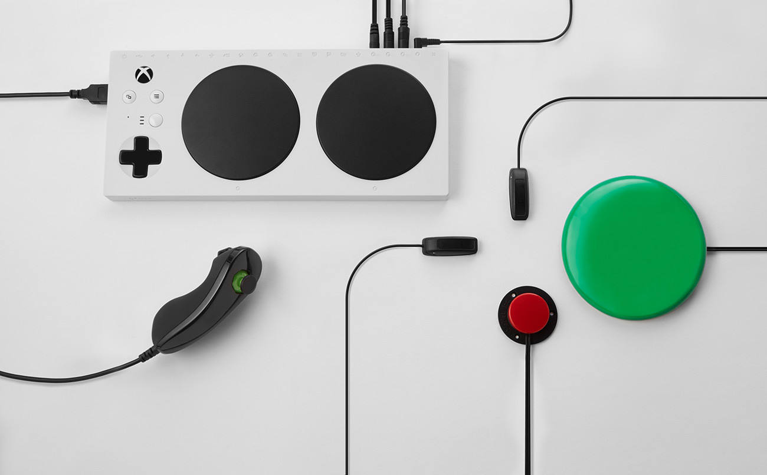
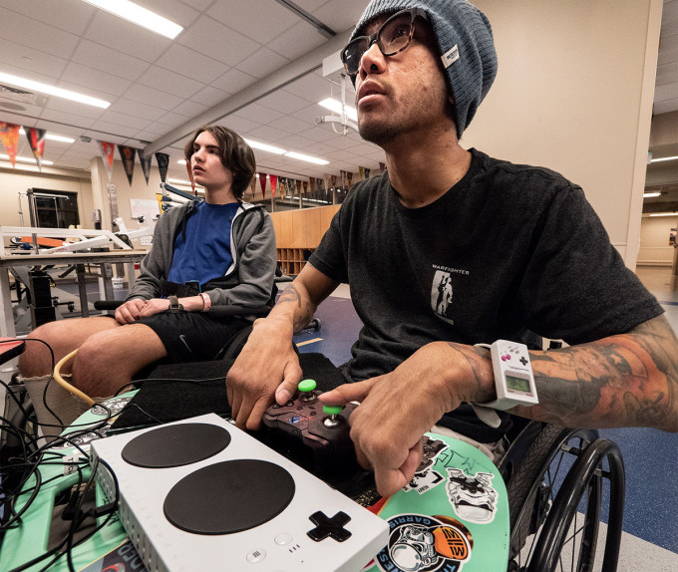
Exemples de bonne conception inclusive
Notes:
Microsoft’s Xbox Adaptive Controller is an inspiring example of inclusive design
Every gamer with a disability faces a unique challenge for many reasons, one of which is the relative dearth of accessibility-focused peripherals for consoles. Microsoft is taking a big step toward fixing this with its Xbox Adaptive Controller, a device created to address the needs of gamers for whom ordinary gamepads aren’t an option.

Slide 35
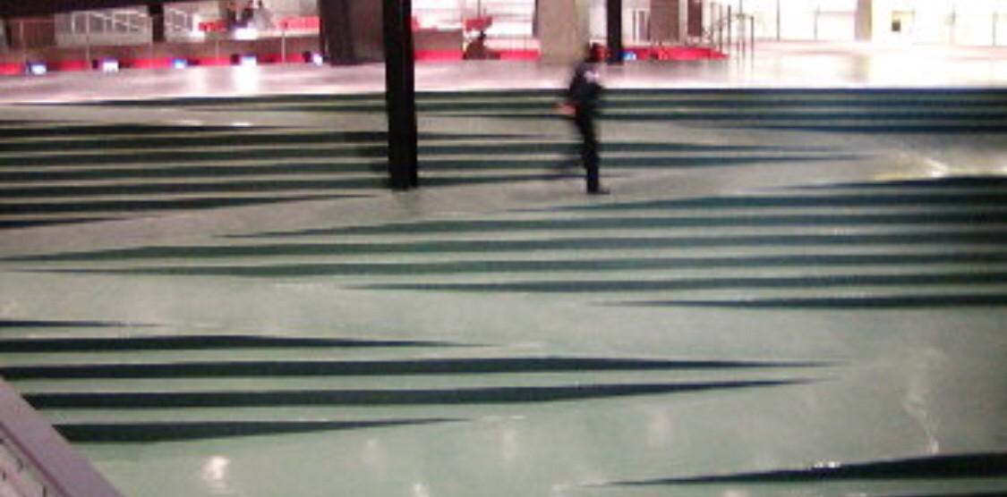
Exemple de « mauvaise » conception inclusive
Notes:
Combined ramp and stairs. Ramp zig zags across stairs.
I am reminded of discussions, maybe 2-3 years ago, about that combined staircase and ramp in the photo above. I think it is in Vancouver but I may be wrong (addition: thanks to Dean Birkett in the comments, it’s in Robson Square in Vancouver).
Again, it looks great.
Again, it got lots of coverage as cool design
Again, it was silly.
The practical problems were that:
for wheelchair users: it was too steep
for people with walking impairments: there were not enough handrails
for everyone: there were trip hazards
Looking cool and being usable is entirely possible but we need to point out when it doesn’t work.

Slide 36
Aspects pratiques à considérer
Reconnaître les préjugés
Faire de la recherche en conception
Suivre les pratiques éthiques
Faire de l’écoute active
Faire la mise à l’essai avec les utilisateurs
Considérer divers besoins
Bâtir des profils inclusifs
Effectuer des inspections cognitives
Offrir diverses façons de participer
Bonnes pratiques pour établir des expériences et des services inclusifs en prenant en compte divers besoins

Slide 37
Éléments à considérer
Orientation
Portée
Itération
Idéation
Optimisation
pour « réussir » une conception inclusive
Notes:
Before deciding on colours, fonts, etc., it is important to get the wireframes of the new website ready. The main issues to consider from an accessibility point of view is that the content must have a meaningful reading order with consistent navigation and layout throughout the website. These two components will benefit all the website visitors not just people with disabilities.
Other factors to consider in the design process is using scalable fonts and having sufficient colour contrast. It is important to remember that the visual appearance of a site is controlled by style sheets; accessibility should not have any impact on visual design.
At the end of the process you will end up with an accessible and usable website by a large diverse set of users. It is important to design for people who are young, old, frequent users, casual users, and those who just enjoy a quality experience.

Slide 38
Activité 2 : Boîte à outils pour la conception inclusive
Notes:
Time: 20 Minutes

Slide 39
Qu’est-ce que l’accessibilité
Notes:
Time: 40 Minutes

Slide 40
Accessibilité
L’accessibilité vise à faire en sorte que tout ce que nous concevons – produits, services, appareils ou environnements – soit accessible aux personnes, peu importent les handicaps.
Notes:
Accessibility

Slide 41
L’accessibilité est une caractéristique, tandis que la conception inclusive est une méthode. L’exercice de la conception inclusive devrait améliorer l’accessibilité des produits, mais il ne s’agit pas d’un processus visant à respecter toutes les normes en matière d’accessibilité. Idéalement, les efforts d’amélioration de l’accessibilité et de conception inclusive s’unissent pour offrir des expériences qui sont réellement utilisables par tous et ouvertes à tous, en plus d’être conformes aux normes. - Boîte à outils de conception inclusive de Microsoft (traduction)

Slide 42
L’accessibilité est notre responsabilité à tous

Slide 43
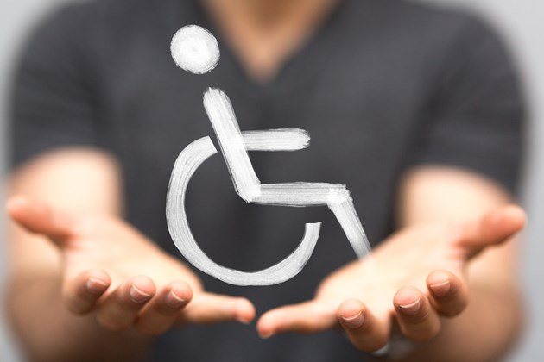
Que pouvons-nous faire pour nous assurer de créer des services inclusifs et accessibles?
Notes:
Incorporates User Research on product teams
Held an accessibility workshop for the entire team
Demoed keyboard and screen reader navigation to a product team
Hosted a Service Design Barriers panel with persons with disabilities from vision, hearing, cognitive and mobility related disabilities
Conducted usability testing from diverse groups include testing with person with disabilities
Written blog’s about accessibility
Much more to come in 2019 - Inclusive Design workshops, partnering with the Canadian School of Public Service, Accessibility clinics for developers

Slide 44
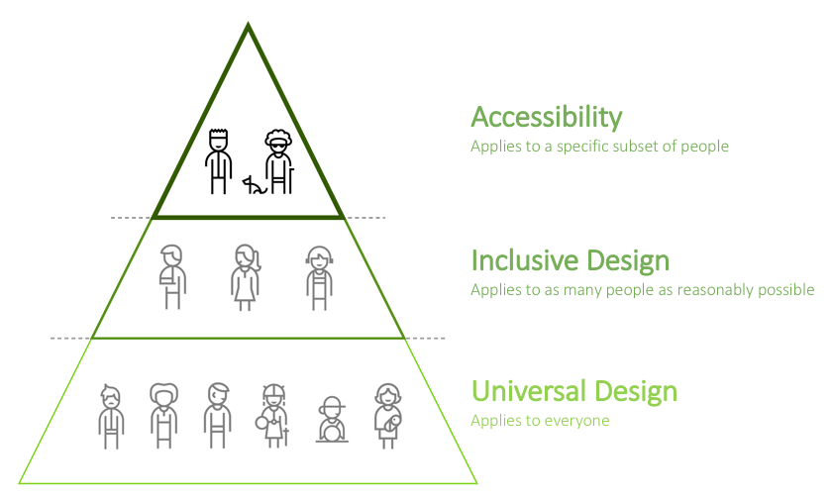
Liens entre la conception inclusive et l’accessibilité
Accessibilité
S’applique à un sous-ensemble donné de personnes
Conception inclusive
S’applique à autant de personnes qu’il est raisonnablement possible
Conception universelle
S’applique à tout le monde

Slide 45
Ces principes sont le fondement des liens entre l’accessibilité, l’inclusion et la diversité.

Slide 46
Les produits et services du gouvernement du Canada doivent-ils être accessibles?
Notes:
Yes. A backgrounder on accessibility in the Government of Canada, the court decision regarding the appeal in the Donna Jodhan case circa 2012. It covers the background, facts & requirements. If you are new to accessibility in the Government of Canada or are indirectly involved in accessibility this is a good place to start. https://bit.ly/2S94ALq "The act will benefit all Canadians, especially Canadians with disabilities, by proactively identifying, removing and preventing barriers in a number of priority areas, while also setting accessibility standards and regulations." - Minister Carla Qualtrough Bill C-81 the Accessible Canada Act went through it's second reading in the senate today. This bill would establish the Canadian Accessibility Standards Development Organization and the position of Chief Accessibility Officer, who would advise the minister on emerging and systemic accessibility issues in Canada.

Slide 47
Les Règles pour l’accessibilité des contenus Web ou WCAG constituent un ensemble de lignes directrices à suivre pour que le contenu soit accessible à tout le monde, y compris les personnes handicapées. Depuis 2012, le gouvernement du Canada doit suivre les règles WCAG 2.0 AA, à la suite d’une décision de la Cour fédérale relative à la cause Donna Jodhan c. le Procureur général du Canada.
Notes:
WCAG was developed by the World Wide Web Consortium (W3C). Although their focus is not solely on accessibility, the W3C is widely regarded as the highest authority in web accessibility goals and universal design.
The consortium provides an online web development resource center that includes sample code implementations to demonstrate and encourage the use of standards, as well as prototypes and sample applications to illustrate new technology.
What is WCAG?
WCAG, which stands for Web Content Accessibility Guidelines, is a set of guidelines making digital content accessible for all users, specifically, users with disabilities.
W3C has released three WCAG versions: WCAG 1.0, 2.0, and 2.1.

Slide 48
Règles pour l’accessibilité des contenus Web
Décrivent les pratiques exemplaires pour que le contenu Web soit universellement perceptible, utilisable, compréhensible et robuste.
Définissent les critères de réussite d’une conception Web inclusive, selon des niveaux ascendants de conformité (A, AA et AAA).
Rédigées et examinées par une collectivité mondiale d’experts du numérique.
Relient le monde au moyen de normes communes en matière de technologie de l’information et d’expérience utilisateur.
Notes:
WCAG 2.0’s essential design concepts are labeled perceivable, operable, understandable and robust.
Designers and developers are asked to meet all four of these principals for disabled users, and then select a degree of compliance (Level A, AA, or AAA).
The four design principals are defined as follows:
Perceivable: Information and user interface components must be presentable to users in ways they can perceive. This means that users must be able to perceive the all relevant information in your content.
Operable: User interface components and navigation must be operable. This means that users must be able to operate the interface successfully.
Understandable: Information and the operation of user interface must be understandable. This means that users must be able to understand the information as well as the operation of the user interface.
Robust: Content must be robust enough that it can be interpreted reliably by a wide variety of user agents, including assistive technologies. Content must be accessible to all users, keeping up with advances in technology, such as mobile technology.

Slide 49
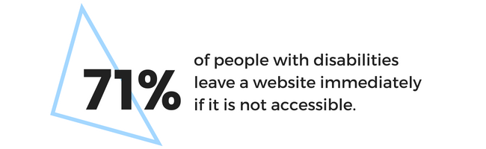
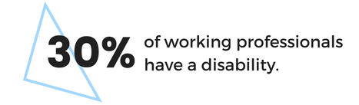
des personnes handicapées quittent un site Web immédiatement s’il n’est pas accessible.
des professionnels actifs ont un handicap.

Slide 50
Idées fausses – Concevoir pour l’accessibilité
Notes:
Good inclusive design is complex. It is not a barrier to innovation in design, and the end-result does not have to be lifeless or bland.
Accessibility does not mean removing all colour and graphics. What it does mean is that you must think about how colour is used, and provide alternative content for images and other graphical objects that are informational or functional. Although you must adhere to some constraints when designing with accessibility in mind, working within these guidelines will create a good-looking website that is usable by all your visitors.

Slide 51

Introspection
Les principes directeurs pour la création de services accessibles et inclusifs forment un ensemble cohérent de lignes directrices pour rendre le contenu accessible aux personnes handicapées. Ces principes sont les suivants : perceptible, utilisable, compréhensible et robuste.
Ces principes visent à créer des expériences bien structurées, simples et intuitives.

Slide 52
An image is worth 1,000 words. And it can cover the whole slide

Slide 53
Les personnes d’abord : suivre les principes de conception inclusive pour assurer un accès égal en donnant un expérience comparable aux personnes ayant des capacités diverses

Slide 55
Inclure l’accessibilité dès le début de la conception d’un service

Slide 56
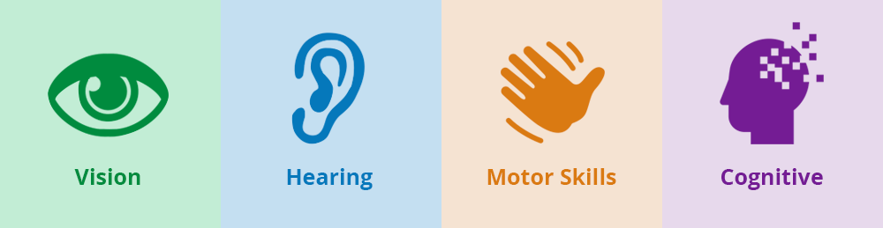
Audition
Motricité
Cognition

Slide 57
S’efforcer d’avoir un but clair et des objectifs bien définis

Slide 58
Veiller à ce que le contenu soit clair, utiliser une langue claire

Slide 59
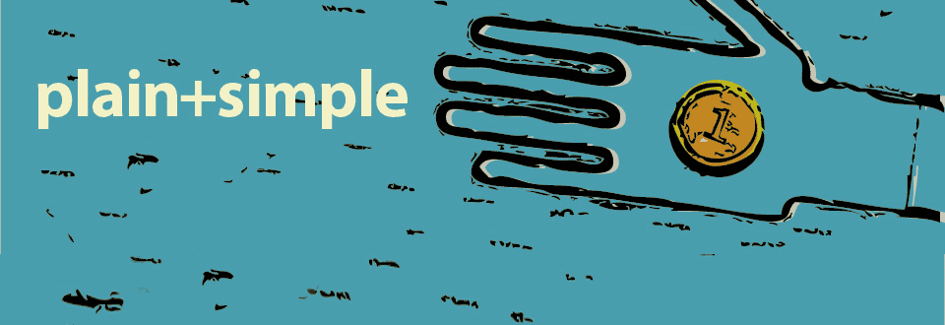
clair+simple

Slide 60
Donner une orientation utile — aider les personnes à naviguer vers le contenu pertinent

Slide 61
Répondre à un éventail de besoins des personnes en offrant des choix et de la flexibilité

Slide 62
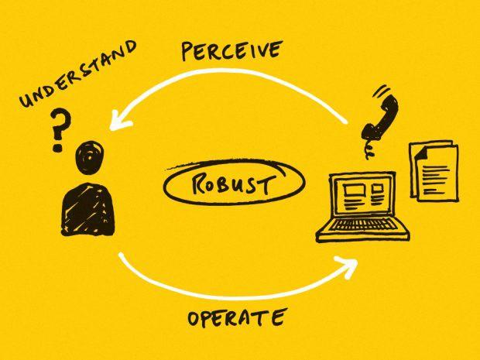

Slide 63
Inclure des personnes handicapées dans la recherche sur les utilisateurs, la conception et la mise à l’essai des services

Slide 64
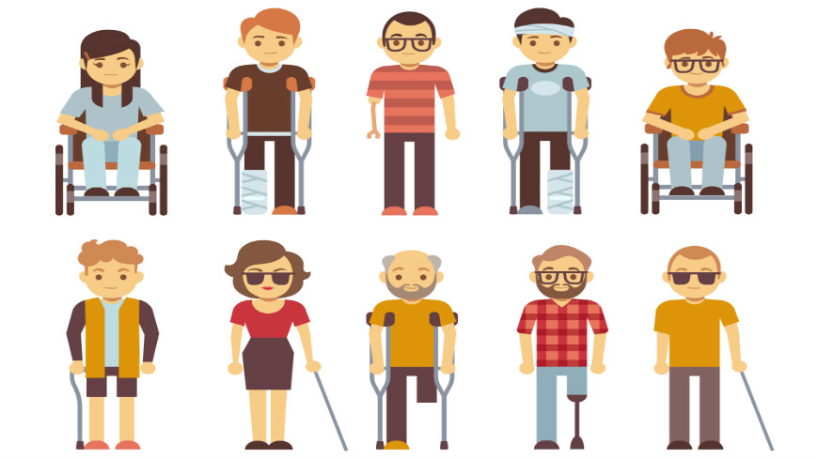

Slide 65
Utiliser une structure solide en s’appuyant sur les normes : s’efforcer de respecter les Règles pour l’accessibilité des contenus Web (WCAG 2.1)

Slide 66
Faire l’essai des éléments en ligne d’un service pour vérifier leur compatibilité avec les technologies d’assistance

Slide 67
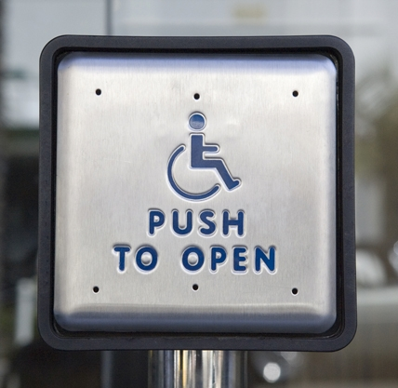

Slide 68
Avoir des champions de l’accessibilité dans les équipes de produits et les équipes de soutien interne

Slide 69
Assurer la compatibilité des ressources avec les outils actuels et à venir, et inclure des modalités redondantes en offrant des choix

Slide 70
Aspects pratiques à considérer
Équivalents textuels
Adaptabilité
Perception facilitée
Accessibilité au clavier
Temps
Sécurité neurologique
Navigabilité
Lisibilité
Assistance à la saisie
Compatibilité
Bonnes pratiques pour rendre le contenu Web universellement perceptible, utilisable, compréhensible et robuste

Slide 71
Ensemble, nous pouvons accroître l’inclusivité et l’accessibilité des services.

Slide 72
Questions?

Slide 73
Feuille de route pour l’accessibilité

Slide 74
Feuille de route pour l’accessibilité
Être pragmatique : aller de l’avant en matière d’accessibilité
Renforcer la capacité d’inclusion
Prioriser le changement
Inclure des personnes handicapées
Attribuer un budget
Exploiter l’expertise d’autres secteurs
Les services accessibles coûtent moins cher
Planifier en vue d’une amélioration continue
La tâche semble colossale : il faut commencer par commencer
But : Chercher à faire mieux qu’hier

Slide 75




numerique.canada.ca
@CDS_GC
github.com/cds-snc

